Slide 1

The science of urban air quality
Mike Pilling
Director, Distributed Institute for Atmospheric Composition
University of Leeds

Slide 2
Urban air quality – National objectives
Pollutant | Concentration μg m⁻³ | Measured as | Date for achievement
NO₂ | 200 40 | 1 h mean Annual mean | end 2005
Particles, PM₁₀ | 50 40 | 24 h mean Annual mean | end 2004
O₃ | 100 | Daily max, running 8 mean | end 2005
Based on health protection
Permitted numbers of exceedances
EU – AQ Framework and daughter directives
DEFRA – Policy, strategy, monitoring, advice

Slide 3
Urban air quality – the challenges
Sources - Largely traffic in urban areas; some industrial. NO₂ and O₃ are secondary pollutants
Variability in time & space - Few monitoring sites. Need understanding & modelling; low cost monitors
Health - Understand and improve basis of objectives and of personal exposure
Models - Needed for prediction and forecasting. High level and for local authorities. Include sources, chemistry, meteorology
Aim - To provide the scientific understanding for policy and practice, allowing improvement in air quality compatible with achievable cost

Slide 4
Street scale – NO₂
Affects airways, lung function, response to allergens
NO is primary pollutant, converted to NO₂ in minutes by reaction with O₃
Spatial distribution related to:
  emissions from traffic: flow, vehicle, driving pattern
  Local meteorology – street canyon effects
  Regional meteorology – inversions
  Chemistry
Annual mean (40 mg m⁻³) difficult objective for some cities

Slide 5
Dispersion of Atmospheric Pollutants & Penetration into Local Environment - DAPPLE (EPSRC)
Surrey – Bristol - Cambridge - Imperial – Leeds - Reading
APRIL – air pollution research in London (DEFRA,EA,EPSRC)
Exchange and entrainment
movement of air and people, interaction between emissions, dispersion, built environment topography and exposure to air pollution.
Deposition
Emissions
Indoor
Air
Mixing through cross-streets
Notes:
DAPPLE project on local scale: funded by EPSRC- see further slides

Slide 6
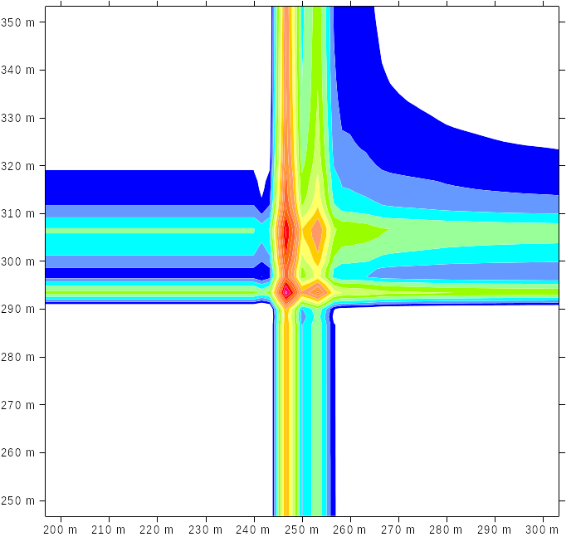
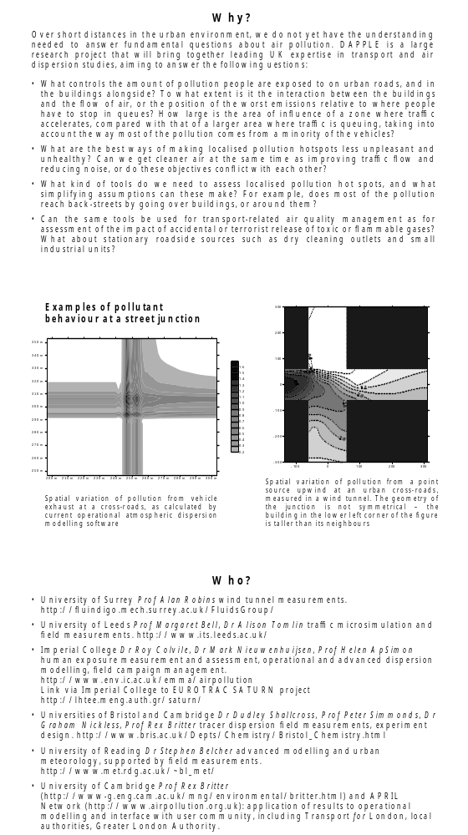
Dispersion at intersection of two building-lined streets
Operational dispersion model - reality of central emissions hot spot?
Wind tunnel measurement of a plume from a point source, asymmetry induced by taller building at lower left

Slide 7
LANTERN (Leeds – JIF + EPSRC funded)
Engine emissions - Instrumented vehicle, rolling road
Transport models - Institute for Transport Studies
Measurements:
  Traffic flows
  Atmospheric dynamics
  Chemistry – gas phase and particles
  Instrumented cities – Nottingham, Leicester
  City scale and street canyon
Dynamics models - Turbulent mean flow + statistics
Molecular epidemiology - biomarkers, e.g. for polycyclic aromatic hydrocarbons.
Links - Local authorities, TRL, DoH, DAPPLE

Slide 8
Integration
Wide range of activity (APRIL, DAPPLE, LANTERN, PUMA)
Links to DEFRA, local authorities; some links to DoH, EA
Activity across NCAS. Application of large-eddy and other turbulence models.
Opportunities for observations, especially in local/regional interactions

Slide 9
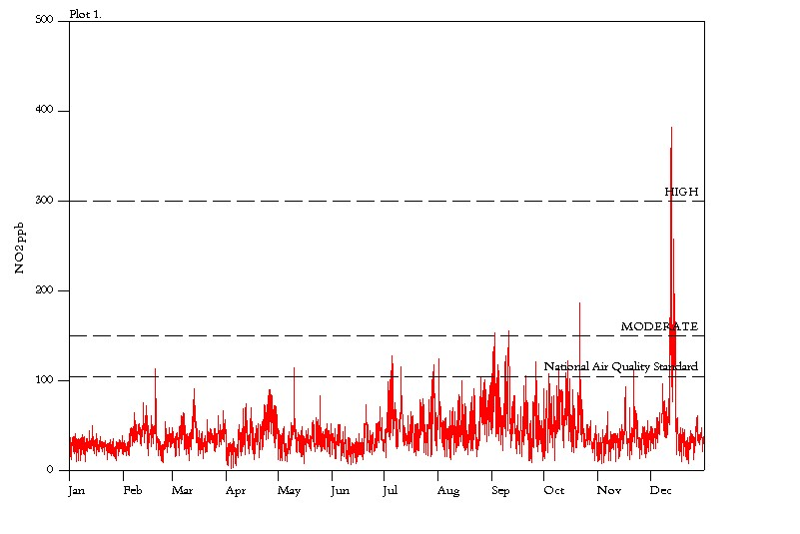
City-scale air pollution and meteorology
Inversion extending over several days in London, December 1991
[NO₂] exceeded current objective for 1 hour mean by >3x
High hospital admissions, several deaths
What is the frequency of similar episodes in highly populated areas?

Slide 10
Particles
Affect respiratory and cardiovascular systems, asthma and mortality
Size dependent. Fine and ultra fine most penetrative
Three types: primary (road traffic); secondary (sulphate, nitrate, organic, formed chemically); coarse (e.g. resuspended road dust)
Problems with measurement methodology
Evolution of particles depends on chemistry and meteorology
About 15% of PM₁₀ and about 50% secondary particles from Europe.

Slide 11
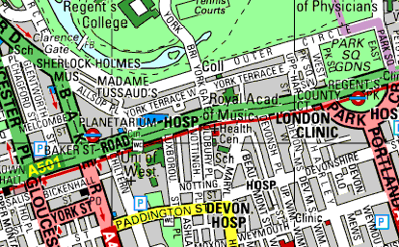
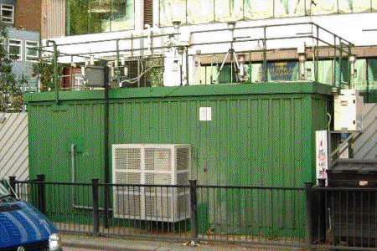
Observations in London
University of Birmingham experiments
Road side laboratory

Slide 12
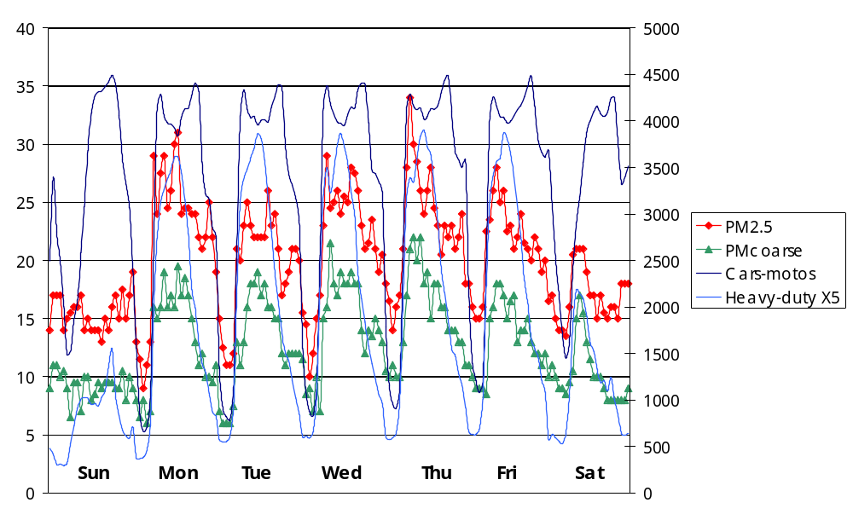
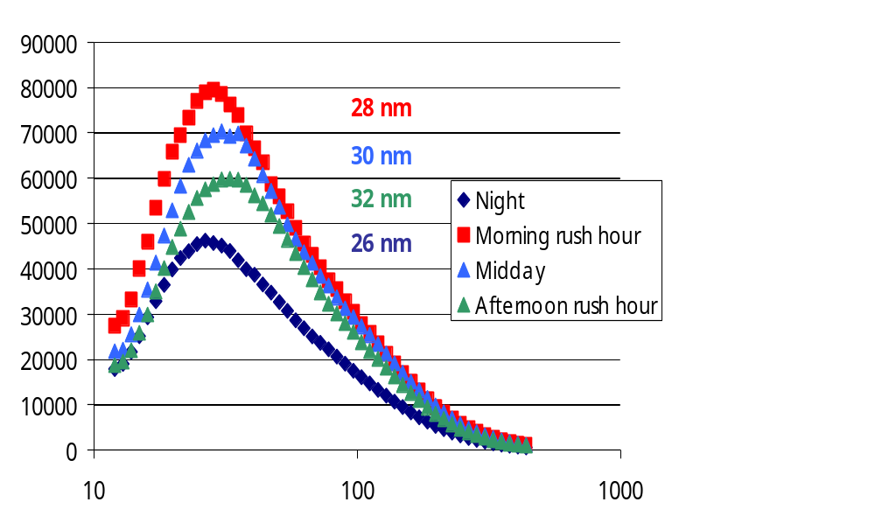
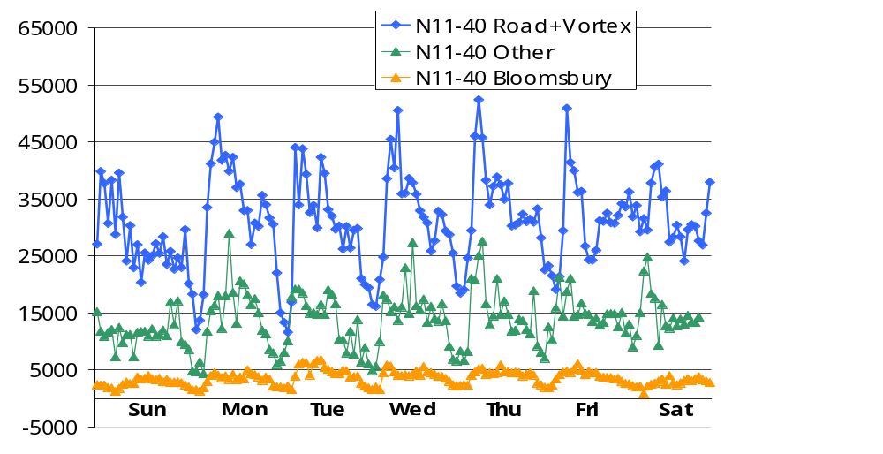
A
Correlation of particle number with traffic
Size distribution varies during day
Number and size distribution of ultra fine particles varies with wind direction
B
C

Slide 13
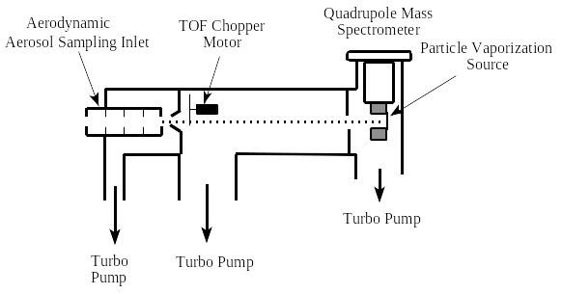
The future: chemical speciation of sized particles
Aerosol mass spectrometers
Birmingham & Edinburgh
Aerosol time of flight mass spectrometer
Sizes individual particles
Laser desorption + ionisation – detects + and - ions
UMIST
Complete mass spectrum for total aerosol or
12 m/z for sized particles (size by time of flight
+ ions
- ions
ZAP!

Slide 14
Ozone
Affects airways, lung function. Links to asthma. Also affects plant growth, materials
Formed by photochemical oxidation of volatile organic compounds (VOCs) in presence of NO_{x}
Chemistry complex; timescale hours to days – regional and transboundary nature.
Episodes under anticyclones – significant European source
Depressed in cities by reaction with NO. Rural concentrations higher.
Chemistry non-linear; strategy decisions (NO_{x} vs VOC control) complex

Slide 15
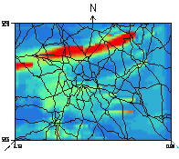
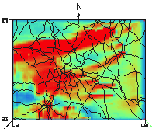
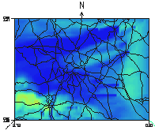
Surface concentration of NOx, NO₂ and O₃ during PUMA campaign
Simulations use a meteorological model with lumped chemistry
(University of Birmingham)
NO_{x}
NO₂
O₃

Slide 16
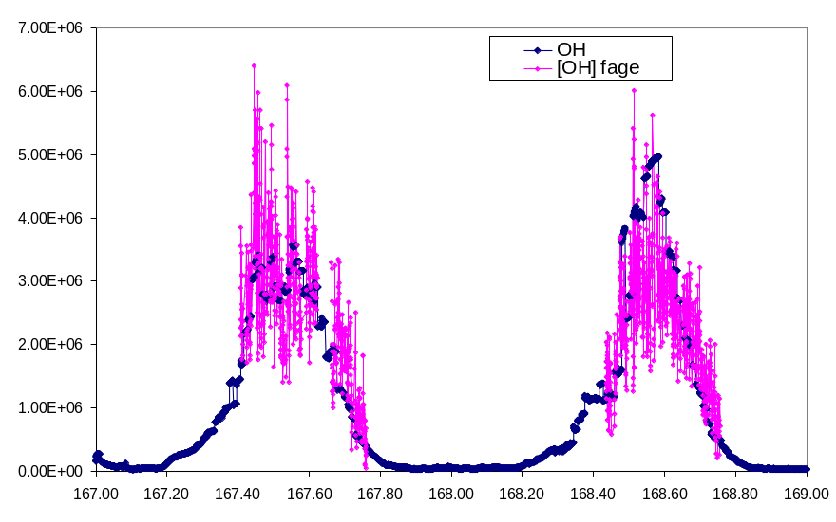
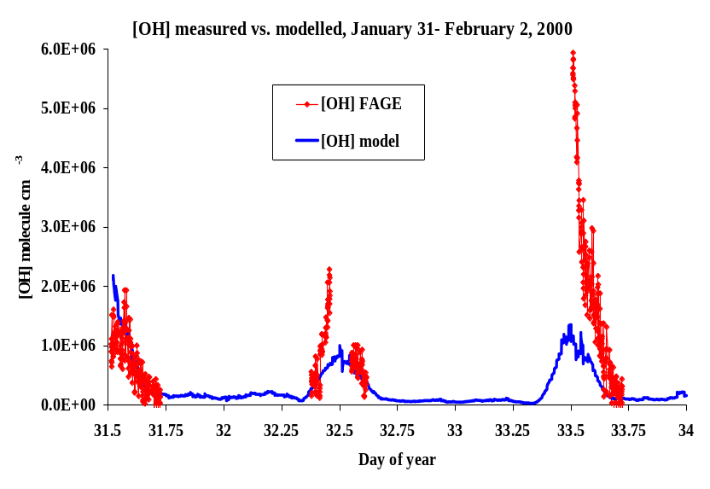
Field measurements of OH
A
OH radical drives atmospheric oxidation
Measure OH and wide range of longer-lived species (NO_{x}, O₃, VOCs, etc)
Model OH using chemical box model, compare with measurement
A shows results from PUMA
OH is primarily produced photochemically
Expect very low winter concs.
Concentrations are high (B)
Chemistry driver = ozone + alkenes
Implications for winter time chemical processing?
B

Slide 17
The future: Conurbation scale air quality
Exploitation of new measurement facilities
Integration of measurements of atmospheric dynamics and chemical processes
Development of conurbation scale models, initialised via large scale models – prediction and forecasting with Met Office
Better integration of chemistry into models– new approaches to lumping; laboratory studies
Links to policy, LAQM (NCAS, DEFRA,Local authorities)
Health – need to improve links
Europe

